Slide 1
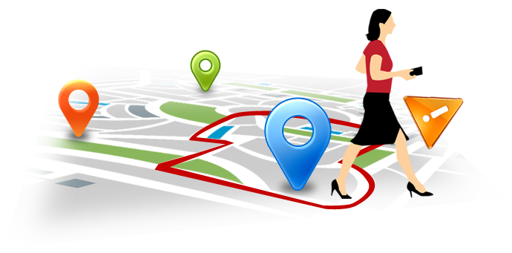
Geo Alert

Slide 2
Introduction
What is Geo-Fence?
What is Geo Alert?
Technologies used to develop

Slide 3
Where it is used?
Child location services
Elder care
Municipal bus systems
Danger zones

Slide 4
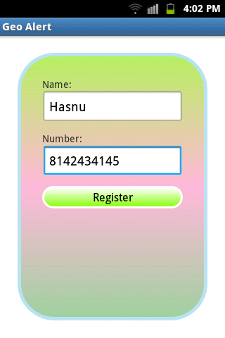
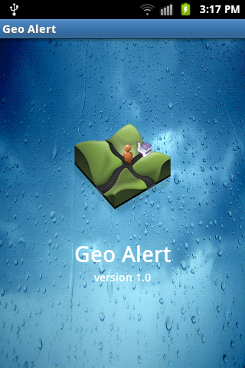
Geo Alert

Slide 5
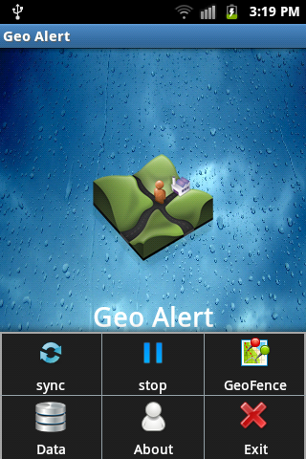
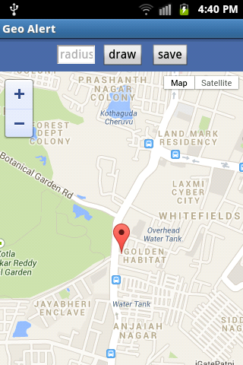

Slide 6
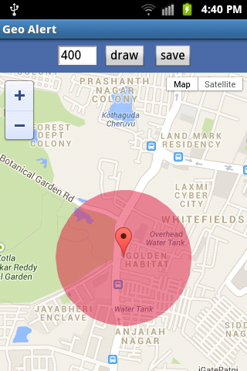
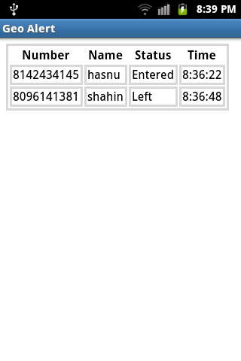

Slide 7
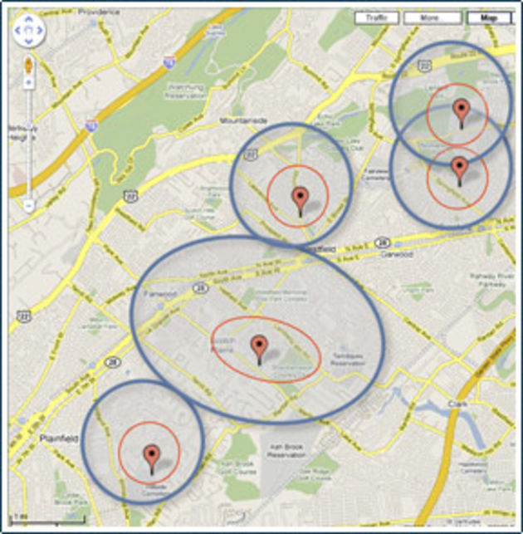
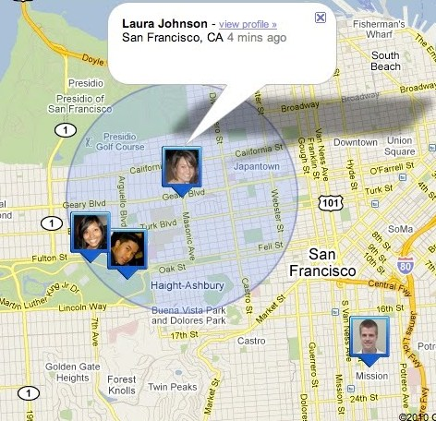
Further implementation

Slide 8


